Slide 1
IAT359 Mobile Computing Spring 2021 Helmine Serban and Vahid Zahednejad

Slide 2
Lecture 5: Storing Data in Android

Slide 3
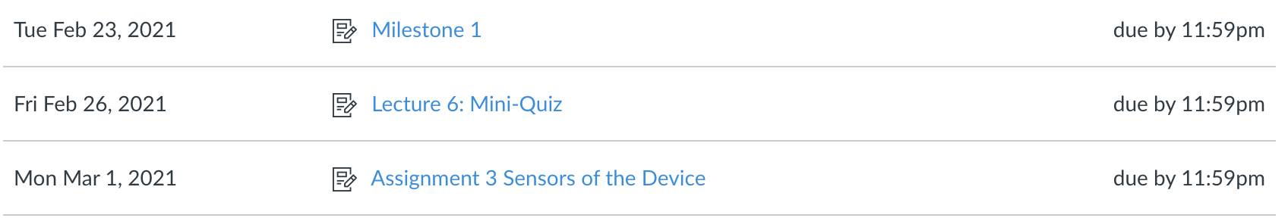
Upcoming Deliverables

Slide 4
Quiz 2
Marks available on Canvas
Review quiz questions in class

Slide 5
Course Project
Milestone 1 due tonight
Milestone 2 – available on Canvas
Review Milestone 2

Slide 6
Android: Checkpoint - Where are we?
The basics
UI
Activities and lifecycle
Navigation between activities
Accessing the device hardware
Today:
data storage

Slide 7
Goals for Today
Data storage options in Android
Shared preferences
SQLite Databases for Android

Slide 8
Android Data Storage

Slide 9
Data Storage Options – Persistent Storage
SharedPreferences
Key-value pairs, private data
Internal Storage
Device memory, private data
External Storage
Shared external storage for public data
SQLite Database
Structured, private data
Network Connection
On the web, with network server

Slide 10
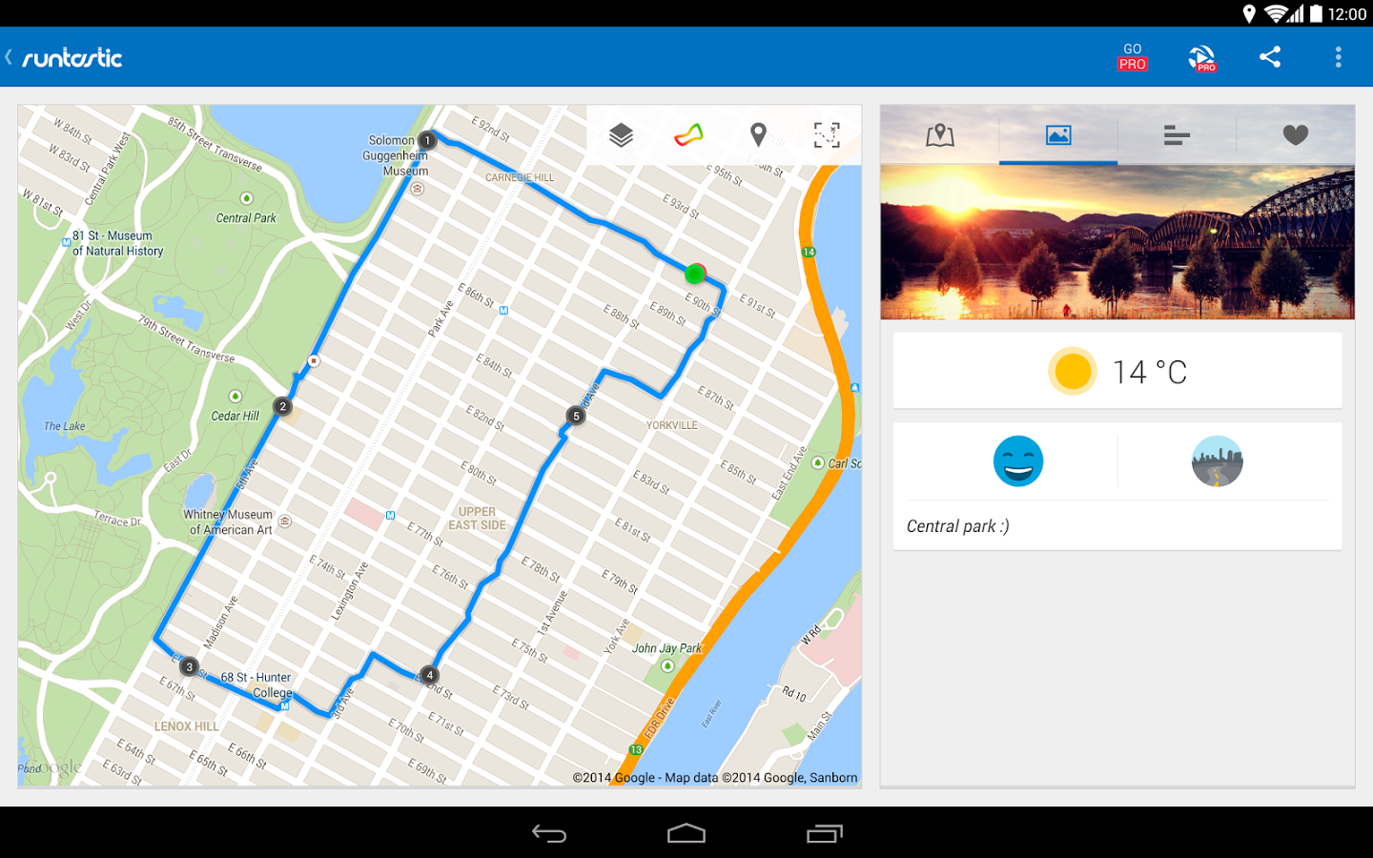
SharedPreferences
Primitive data stored as key/ value pairs
Private to the app
Shared
Preferences
(Runtastic App)
name: runnerDave
weight: 75 kg
Key = name
Value = “runnerDave”
Key / Value pairs
Key = weight
Value = “75”

Slide 11
Android Internal and External Storage
Internal Storage:
Save files directly on the device’s internal storage
Private files to the app
If app is uninstalled, files are removed
External storage
Removable storage media (SD card)
Non-removable internal storage
Readable by anyone

Slide 12
SQLite Database for Android
Structured data
Private to the app
SQLite Database
Shared
Preferences
(Runtastic App)
name: runnerDave
weight: 75 kg
Activity ID | Type | Distance | Time | Calories
27 | Running | 5.2km | 00:38:32 | 348

Slide 13
Android SharedPreferences
Simplest way of storing data in Android – XML file
Key / value pairs
Key | Value
Username | MrSmith
LastName | Smith
FirstName | John
School | SFU
Store the value and use the
corresponding key to retrieve
the value later
Data stored in XML file in data/ data/ <package-name>/shared-prefs

Slide 14
SharedPreferences – What Kind of Data
App settings, theme settings, username, font size, background color, etc
Only allow primitive data types: boolean, long, int, float, string
Not meant for complex data

Slide 15
Accessing Preferences
An app can have one or more preference files
getPreferences()
getSharedPreferences()

Slide 16
Why Use Preferences
User info
Location
Updated
Check when app was last updated
Settings
First time use
Check if the user is using the app for the first time
Remember last user location
Store user settings
Store user details

Slide 17
Use SharedPrefs to Store Data
1. Get a reference to the SharedPreferences object getPreferences() or getSharedPreferences()
3. Use the editor to add the data with a key putBoolean(), putString, etc
4. Commit editor changes commit()
2. Call the Editor edit()

Slide 18
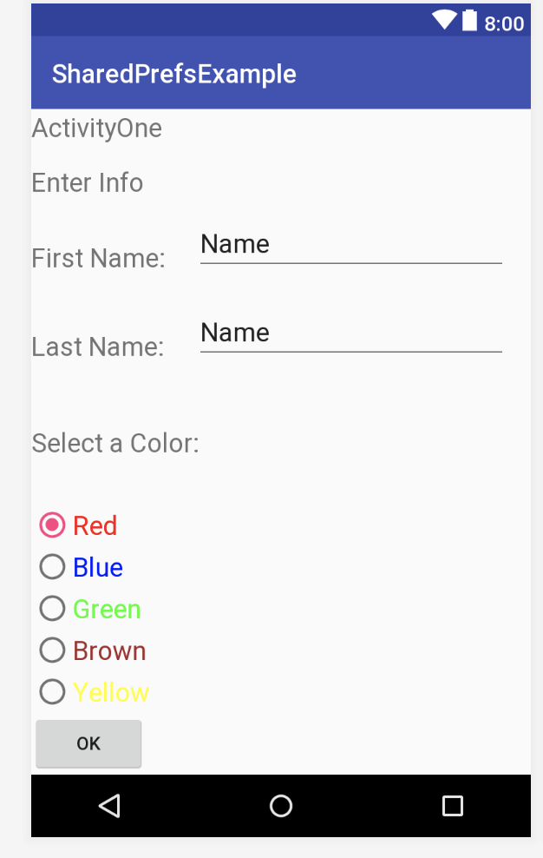
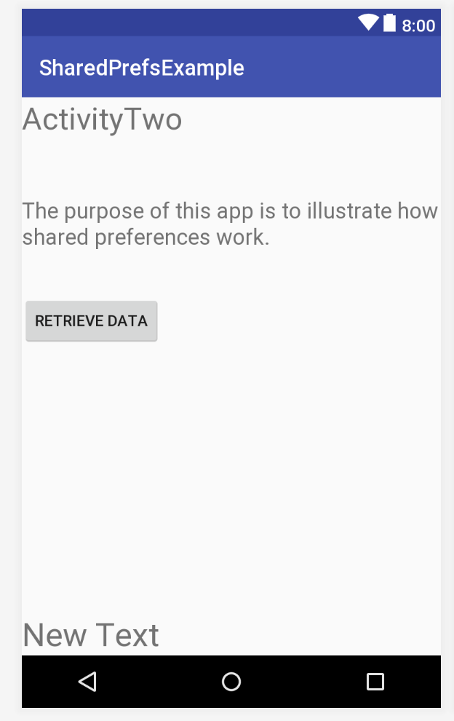
Example using SharedPrefs
ActivityOne
ActivityTwo

Slide 19
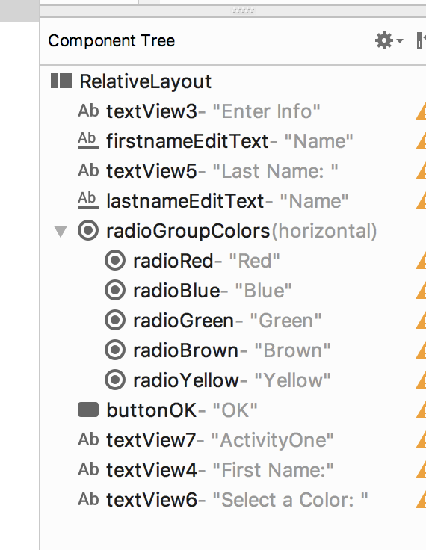
ActivityOne

Slide 20
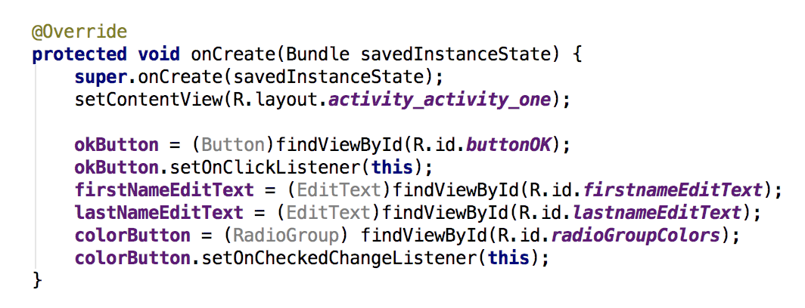
ActivityOne – Get References to UI Elements

Slide 21
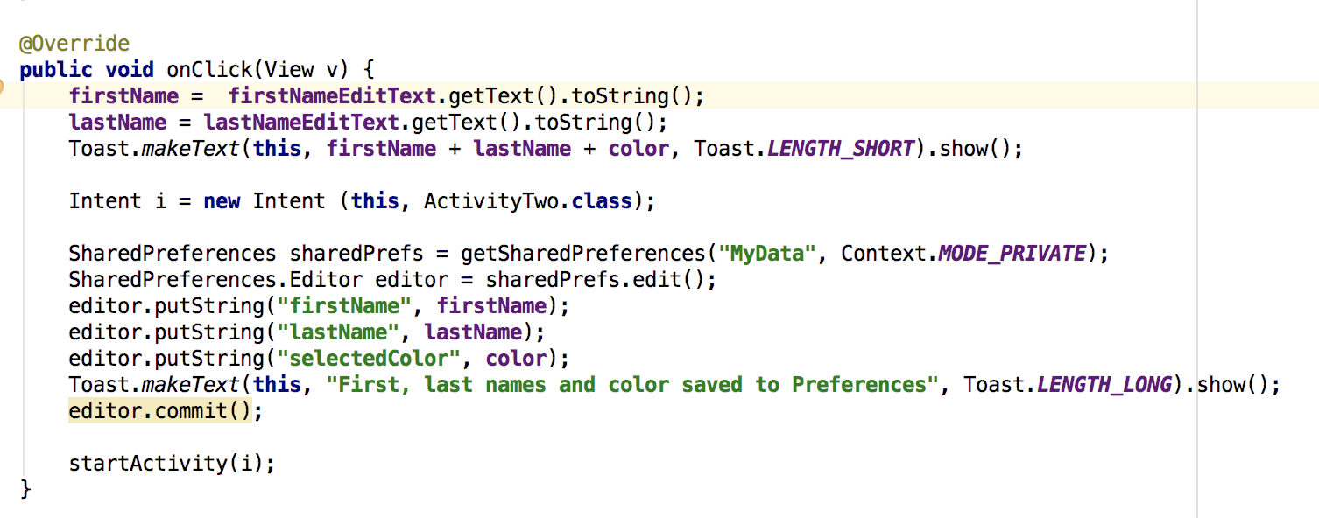
Saving the Data to SharedPrefs
We have to save the names and color
Notice the 4 steps in the code below:

Slide 22
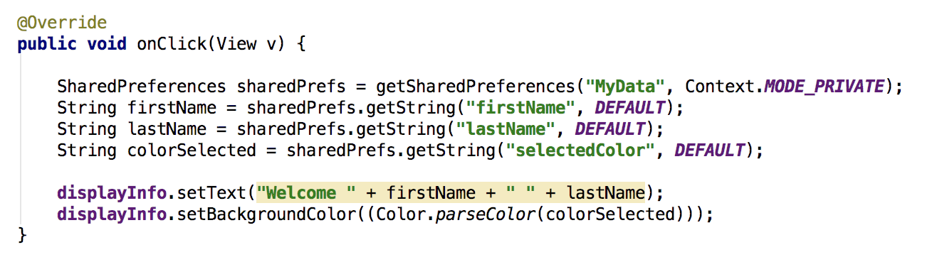
ActivityTwo: Retrieve the Data from SharedPrefs

Slide 23
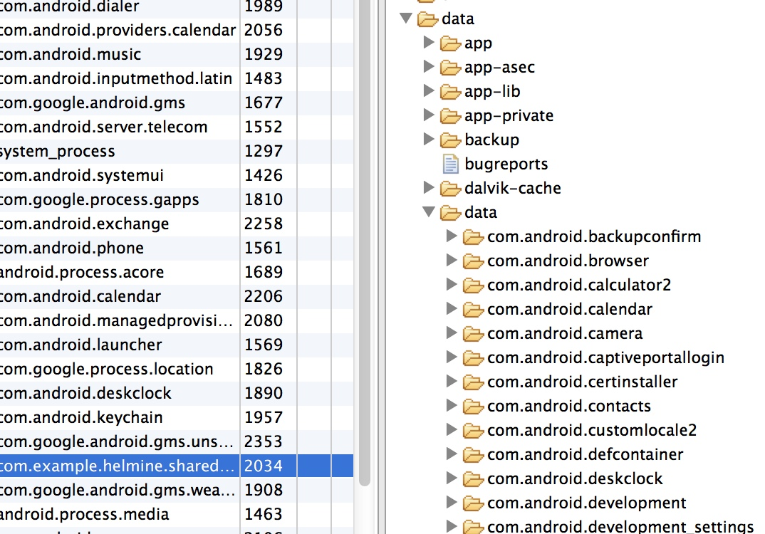
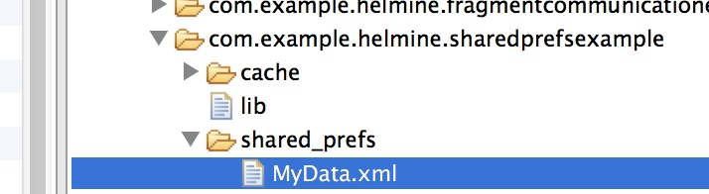
The SharedPrefs File
FileExplorer in AndroidStudio
Find the proper package name
SharedPrefs file is in data/ data/ <package-name>/shared-prefs

Slide 24
SQLite Databases for Android
SQLite: language for managing data in relational databases
Apps have their private SQLite databases
The database of an app is accessible by any class in the app, but not by other apps
/data/data/<package-name>/database folder
App database
Self-contained
Transaction-based
No server

Slide 25
Process
Programmatically create database
insert
update
Class: SQLiteOpenHelper
Methods: onCreate (create the database)
onUpgrade (perform changes to database)
SQLite Database
delete
query
My Application
getWritableDatabase(): when this method
gets called on our implementation of SQLiteOpenHelper,
an SQLite database object will be returned and this is the database of our app

Slide 26
Creating an SQLite Database Schema
1. Define schema – database name, version, table names, column names
3. Execute queries – insert, update, delete operations
2. Create the database – queries to create the database

Slide 27
Step 1: Define Schema
Plant Database
PLANTSTABLE
Notes:
-_id is the primary key
- It identifies a row uniquely
underscore: Android convention
for primary keys
_id | Name
1 | Lavender
2 | Rosemary
3 | Hibiscus
private static final String DATABASE_NAME = “plantdatabase”;
private static final String TABLE_NAME = “PLANTSTABLE”;
private static final String UID = “_id”;
private static final String NAME = “Name”;
private static final int DATABASE_VERSION = 1;
Constant fields, do not change values within our app

Slide 28
Step 2: Create the database – SQLiteOpenHelper
Subclass of SQLiteOpenHelper
Implement onCreate() and onUpgrade()
SQLiteOpenHelper class:
Opens the database if it exists
Creates the database if it does not exist
Updates the database as necessary

Slide 29
SQLiteOpenHelper - Methods
onCreate() – this method is called when the database is first created
Creation of tables
Initial data inside of tables
onUpgrade() – this method is called whenever the database is updated
Drop, add tables
Anything that updates the database structure

Slide 30
SQLiteDatabase class
An object representing the database that we have just created
Method: public void execSQL(String sql)
Executes a single SQL statement
Notice that the method returns void – this is an indication to what type of SQL statements this method can execute

Slide 31
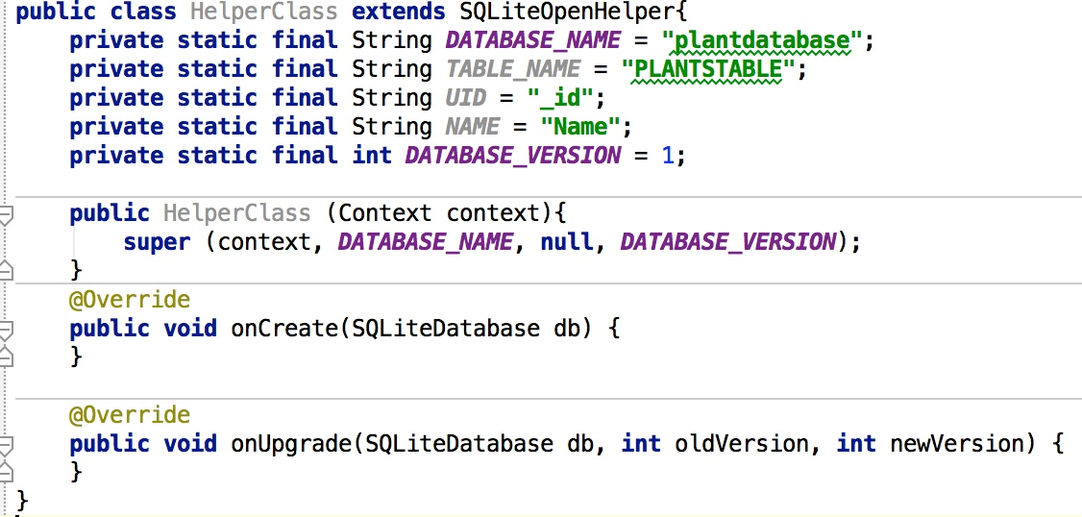
Example Application
1. Create the SQLite Database schema

Slide 32
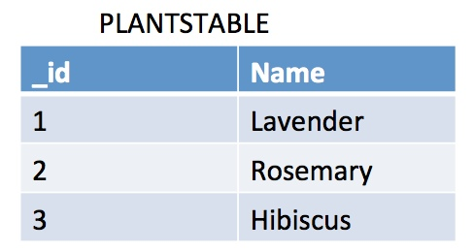
onCreate() Method
Statement to create database:
CREATE TABLE PLANTSTABLE(_id INTEGER PRIMARY KEY AUTOINCREMENT, Name VARCHAR(255));
This can also be written as:

Slide 33
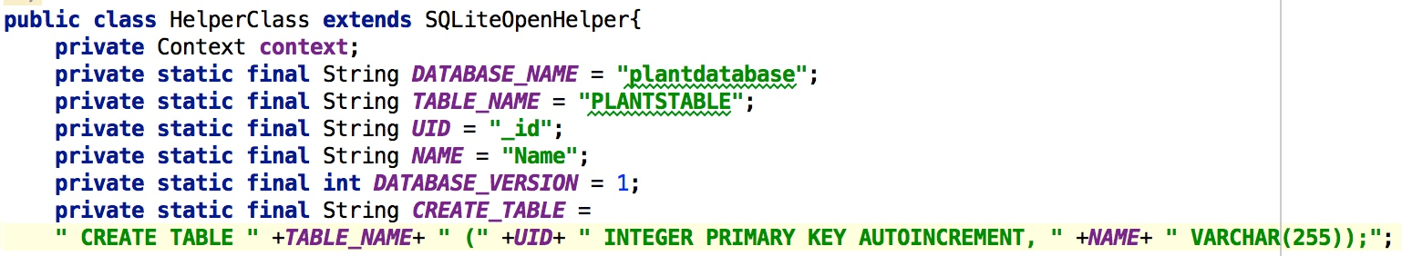
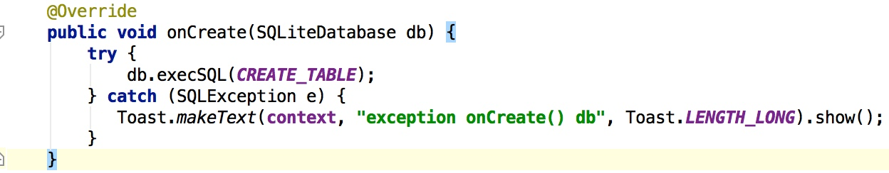
onCreate() Method

Slide 34
onUpgrade() Method
In this method we can do anything that will change the database schema
Modify the table
Delete the table
Add, delete columns
Drop table

Slide 35
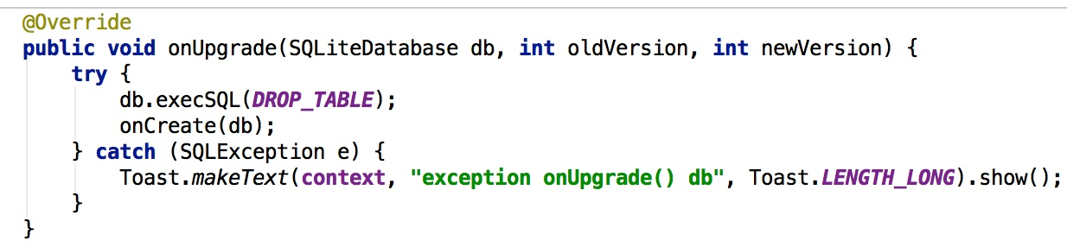
onUpgrade() Method
Example: drop table query

Slide 36
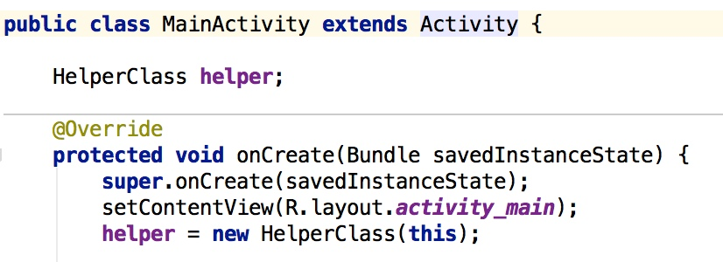
Sample Code: Main Activity
Create an object of the HelperClass
Then, run the app to see what happens

Slide 37
Nothing Happens!!
Why??
IMPORTANT: the database gets created only when there is an attempt to access it for the first time
Since there was no access to our database, the database was not created
This means that onCreate() and onUpgrade() methods have not been called
We have to call the method getWritableDatabase() – returns a database object

Slide 38
Accessing the Database
getWritableDatabase() will return an SQLite database object.
The returned object is a reference to the database that we just created.
Next: run the code again

Slide 39
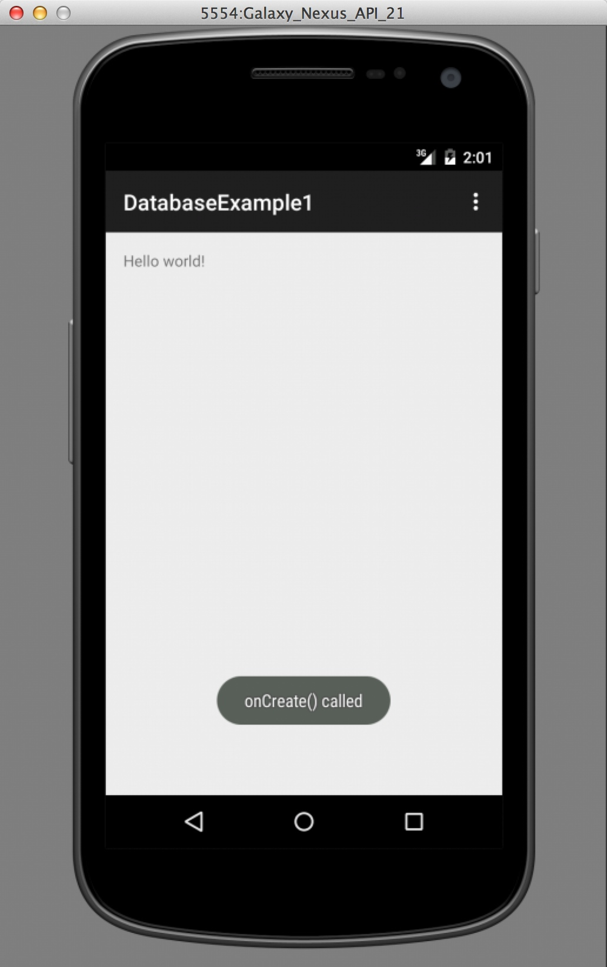
onCreate() called because the
database was accessed for the first
time and this triggered the database
creation

Slide 40
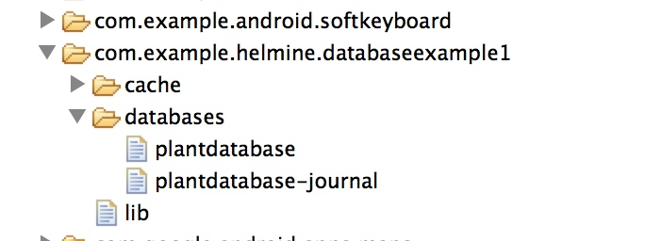
Viewing the Database File

Slide 41
What about onUpgrade()?
When is onUpgrade() called? It is called when a change in the database schema takes place.
The database exists already, let’s modify it by adding one new column: the type of the plant
We also have to change the CREATE_TABLE: (only the change is shown below):
Database version: this also needs to be changed, because we have changed the structure of the database

Slide 42
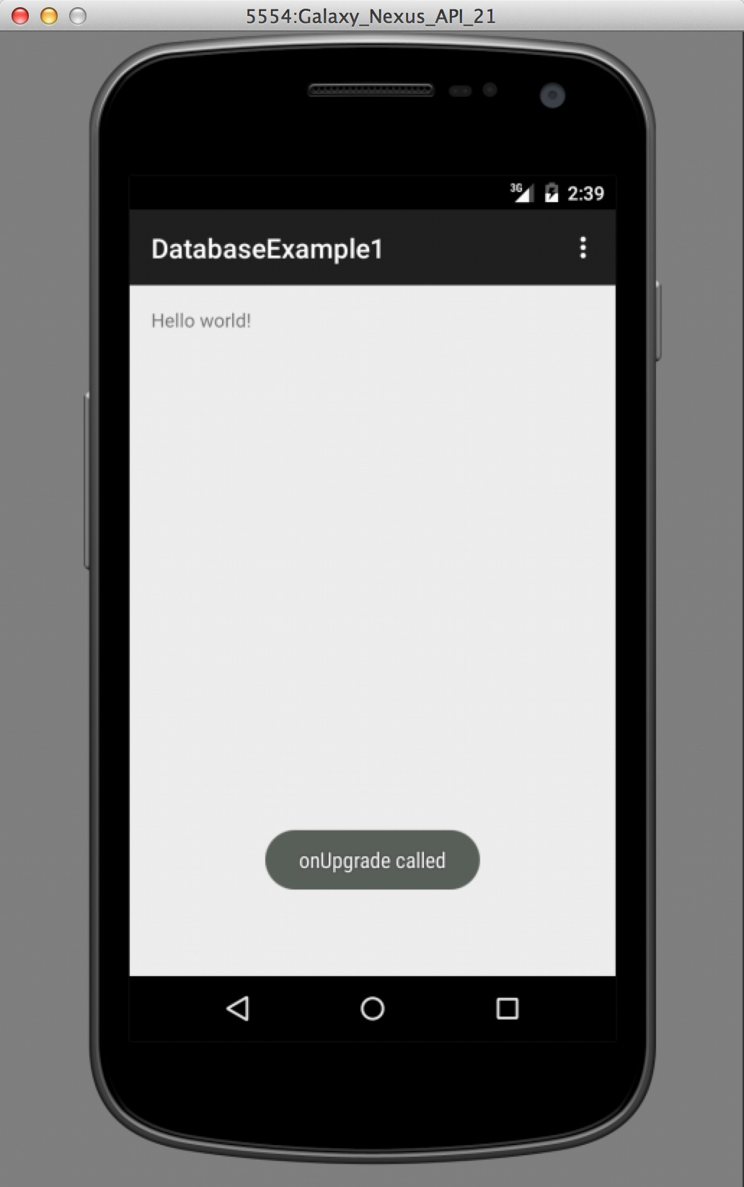
Outcome

Slide 43
Summary of Today’s Class
Data storage options in Android
Shared Preferences (simple, primitive data)
Internal and External Storage (not discussed)
SQLite Databases (complex, structured data)
Shared preferences
when to use this storage method
How to store and retrieve data from SharedPrefs
SQLite Databases for Android
Defining the schema, creating the database
We will continue this topic next week

Slide 44
Readings and Resources
Saving Data - http://developer.android.com/training/basics/data-storage/index.html
Storage Options - http://developer.android.com/guide/topics/data/data-storage.html
Using Databases - http://developer.android.com/guide/topics/data/data-storage.html#db
SQLite official site - https://www.sqlite.org/index.html
SQLite Query Language - https://www.sqlite.org/lang.html

Slide 45
Thank you
Questions?

